Slide 1
Product Backlog
Soon Phei Tin

Slide 2
Objectives
The role of the product backlog
Describing the different types of items that typically populate a product backlog
Discuss four characteristics of a good product backlog
How good backlog grooming helps ensure that those characteristics are achieved

Slide 3
Overview
Product backlog is a prioritized list of desired product functionality
It provides a centralized and shared understanding of what to build and the order in which to build it
It is a highly visible artifact at the heart of the Scrum framework that is accessible to all project participants

Slide 4
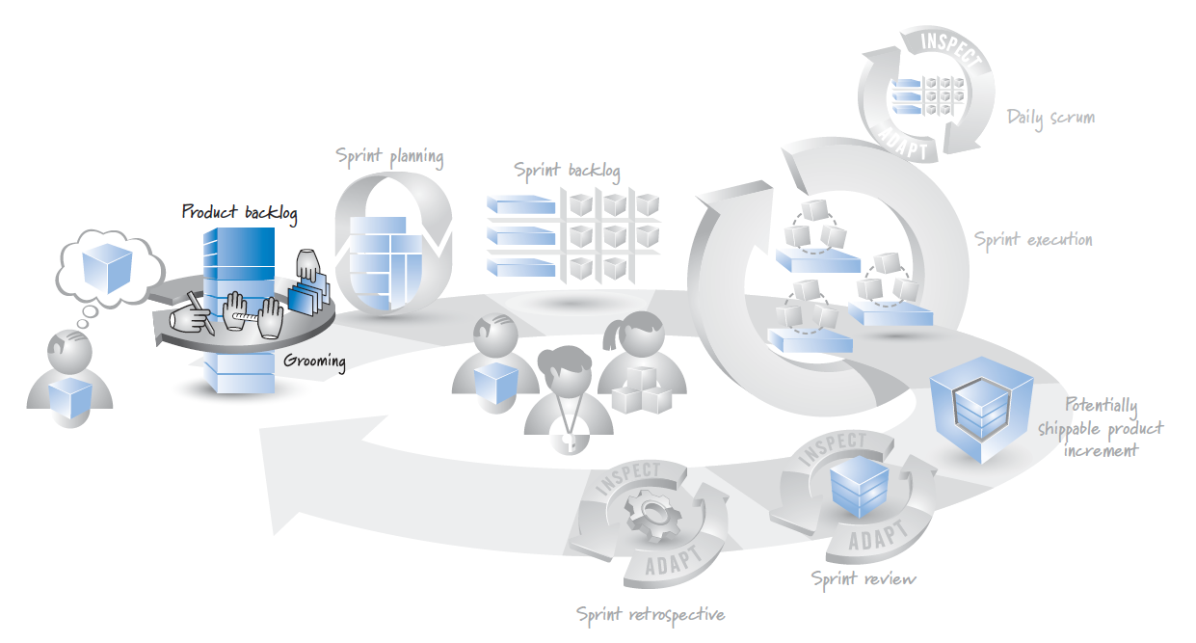
Overview

Slide 5
Product Backlog Items
The product backlog is composed of product backlog items (PBIs), backlog items, or simply items
Most PBIs are features, items of functionality that will have tangible value to the user or customer
Often written as user stories
Examples of features include something brand-new, or a change to an existing feature
Other PBIs include defects needing repair, technical improvements, knowledge-acquisition work

Slide 6
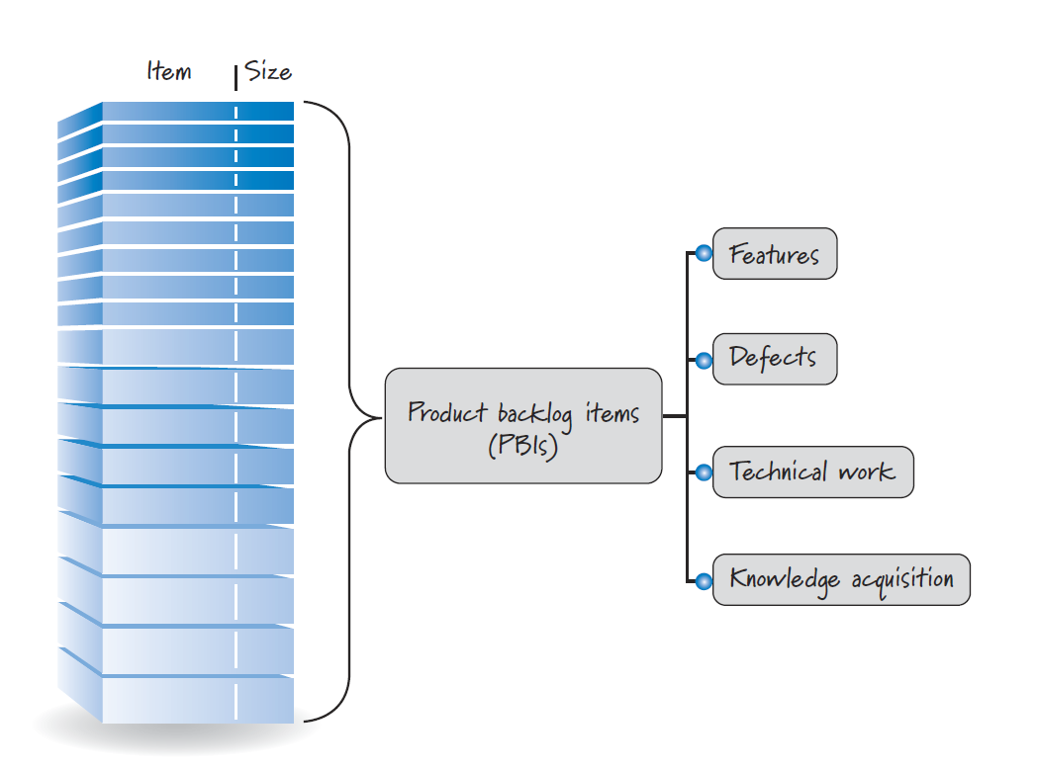
Product Backlog Items

Slide 7
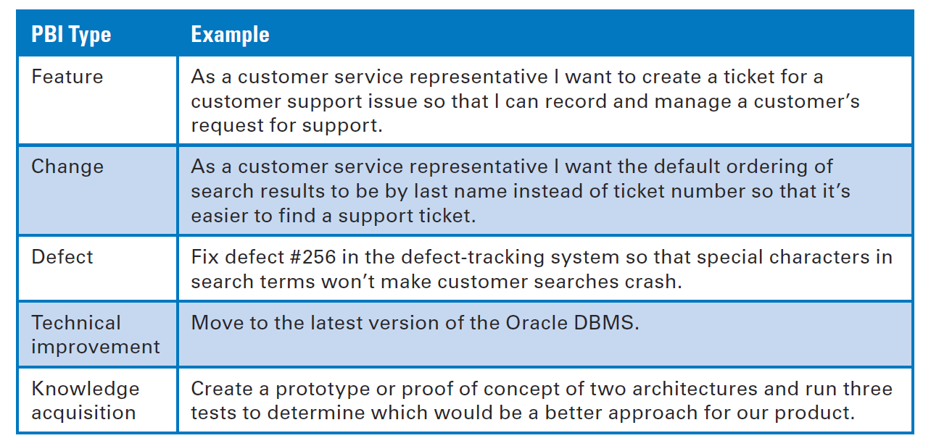
PBI Types

Slide 8
Product Backlog Characteristics
Roman Pichler (Pichler 2010) and Mike Cohn coined the acronym DEEP to summarize several important characteristics of good product backlogs:
Detailed appropriately
Emergent
Estimated
Prioritized

Slide 9
PB Characteristic: Detailed appropriately
Not all items in a product backlog will be at the same level of detail at the same time
PBIs to work on soon should be near the top of the backlog, small in size, and very detailed
PBIs not to work on for some time should be toward the bottom of the backlog, larger in size, and less detailed
As we get closer to working on a larger PBI, break that story down into a collection of smaller, sprint-ready stories
Refine too early, we might spend time figuring out the details, but end up never implementing the story or story get changed
Wait too long, we will impede the flow of PBIs into the sprint

Slide 10
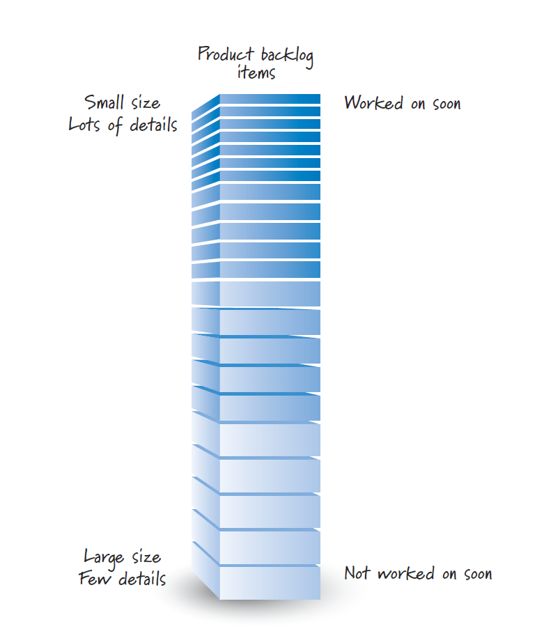
PB Characteristic: Detailed appropriately

Slide 11
PB Characteristic: Emergent
As long as there is a product being developed or maintained, the product backlog is never complete or frozen
The product backlog continuously updated based on a stream of economically valuable information that is constantly arriving
As new items are added or existing items are refined, the product owner must rebalance and reprioritize the product backlog, taking the new information into account.

Slide 12
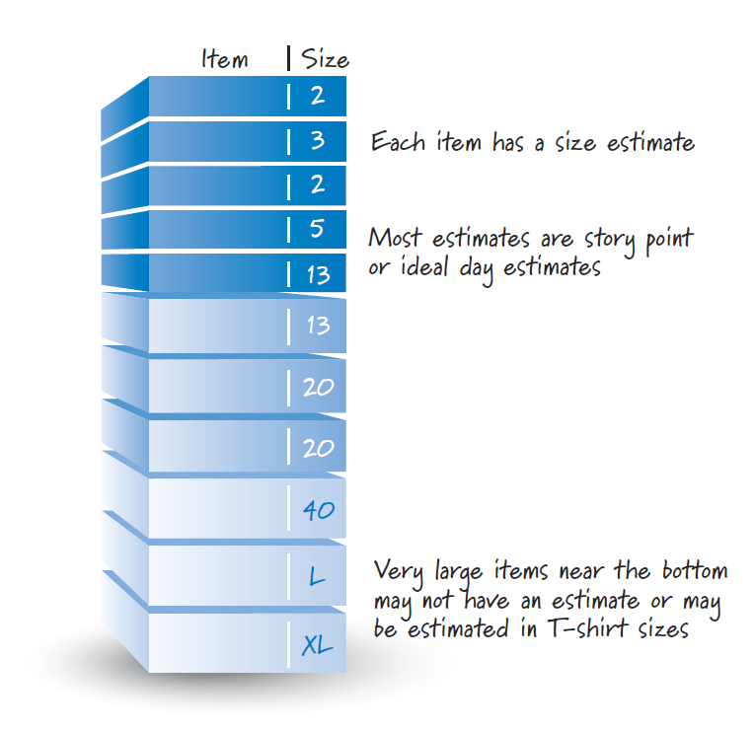
PB Characteristic: Estimated
Each product backlog item has a size estimate corresponding to the effort required to develop the item
The product owner uses these estimates as one of the inputs to help determine a PBI’s priority
High-priority large PBI signals to the product owner that additional refinement of that item is necessary

Slide 13
PB Characteristic: Estimated
Most PBIs are estimated in either story points or ideal days
These size estimates need to be reasonably accurate without being overly precise
Items near the top of the backlog are smaller and more detailed, they will have smaller, more accurate size estimates
It may not be possible to provide numerically accurate estimates for larger items (like epics), so some teams might choose to not estimate them at all, or to use T-shirt-size estimates (L, XL, XXL, etc.)
As these larger items are refined into a set of smaller items, each of the smaller items would then be estimated with numbers.

Slide 14
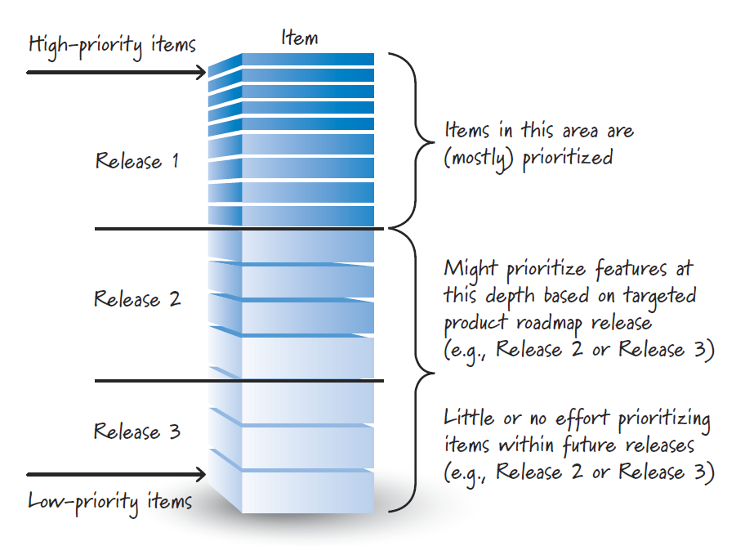
PB Characteristic: Prioritized
It is unlikely that all items in the backlog will be prioritized
It is useful to prioritize the near-term items for the next few sprints
Prioritize as far down in the backlog as we think we can get in one release
Going beyond that point, prioritization is likely not worth our time.

Slide 15
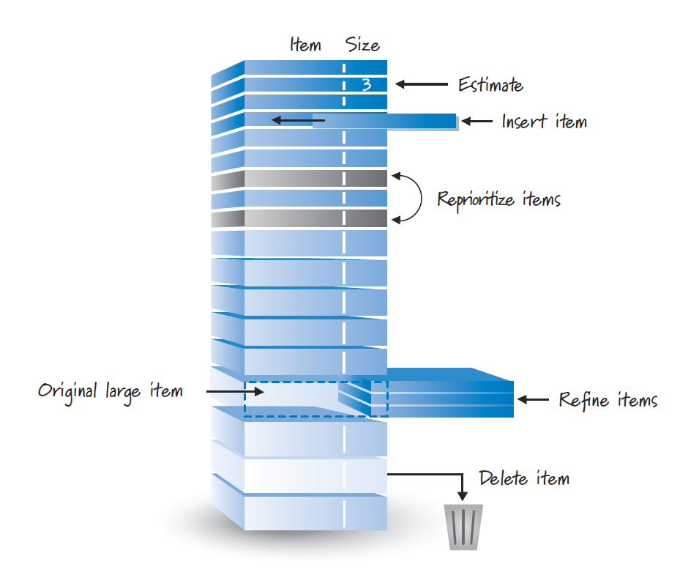
Grooming
To get a good, DEEP product backlog, we must proactively manage, organize, administer them, or, it is commonly known as grooming.

Slide 16
What is Grooming?
Grooming refers to a set of three principal activities:
creating and refining (adding details to) PBIs
estimating PBIs
prioritizing PBIs.

Slide 17
Who does the Grooming?
Grooming is an ongoing collaborative effort led by the product owner and including significant participation from internal and external stakeholders as well as the ScrumMaster and development team
Good product owners understand that: -
Collaborative grooming fosters an important dialogue among all participants and leverages the collective intelligence and perspectives of a diverse group
By involving the diverse team members in the grooming, they ensure that everyone will have a clearer, shared understanding of the product backlog, so less time will be wasted in miscommunications and handoffs

Slide 18
Who does the Grooming?
As a general rule, the development team should allocate up to 10% of its time each sprint to assisting the product owner with grooming activities
to help create or review emergent product backlog items
progressively refine larger items into smaller items
estimate the size of product backlog items
help the product owner prioritize them based on technical dependencies and resource constraints.

Slide 19
When Does Grooming Take Place?
In Scrum, we assume an uncertain environment and therefore must be prepared to constantly inspect and adapt
Product backlog evolves constantly rather than being locked down early and changed only through a secondary process for handling exceptional, undesirable occurrences
Grooming activities are an essential, intrinsic part of how we manage our work

Slide 20
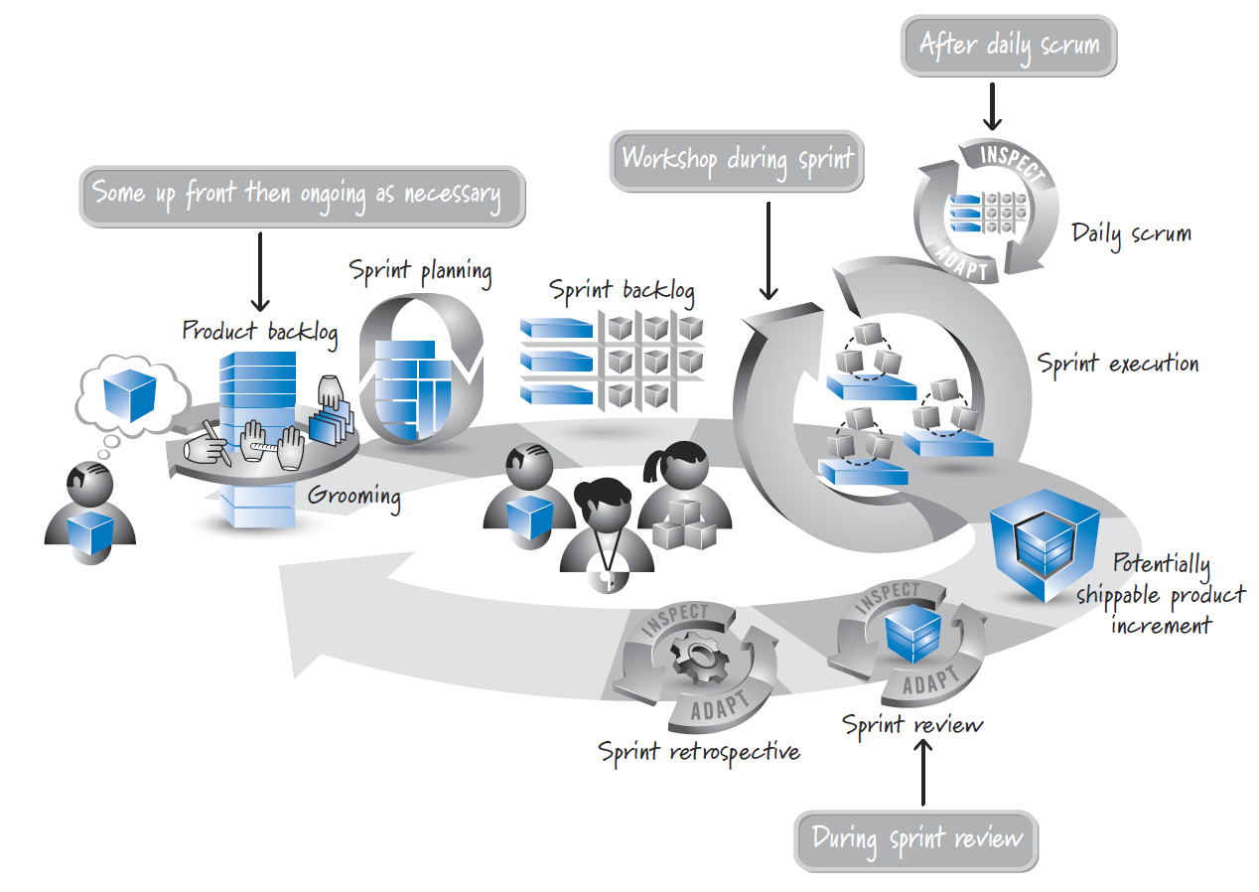
When Does Grooming Take Place?

Slide 21
When Does Grooming Take Place?
Initial grooming occurs as part of the release-planning activity
During product development, the product owner meets with the stakeholders at whatever frequency makes sense to perform ongoing grooming
When working with the development team, the product owner might schedule either a weekly or a once-a-sprint grooming workshop during sprint execution

Slide 22
When Does Grooming Take Place?
Most teams find that they naturally do some grooming as part of the sprint review
Sometimes teams prefer to spread out the grooming across the sprint, rather than block out a predetermined period of time
They take a bit of time after their daily scrums to do some incremental grooming
This grooming doesn’t have to include all of the team members, only who are knowledgeable and interested

Slide 23
Definition of Ready
Grooming the product backlog should ensure that items at the top of the backlog are ready to be moved into a sprint so that the development team can confidently commit and complete them
Some Scrum teams formalize this idea by establishing a definition of ready
Definition of ready and the definition of done are the two states of product backlog items during a sprint cycle
Both are checklists of the work that must be completed before a product backlog item can be considered to be in the respective state

Slide 24
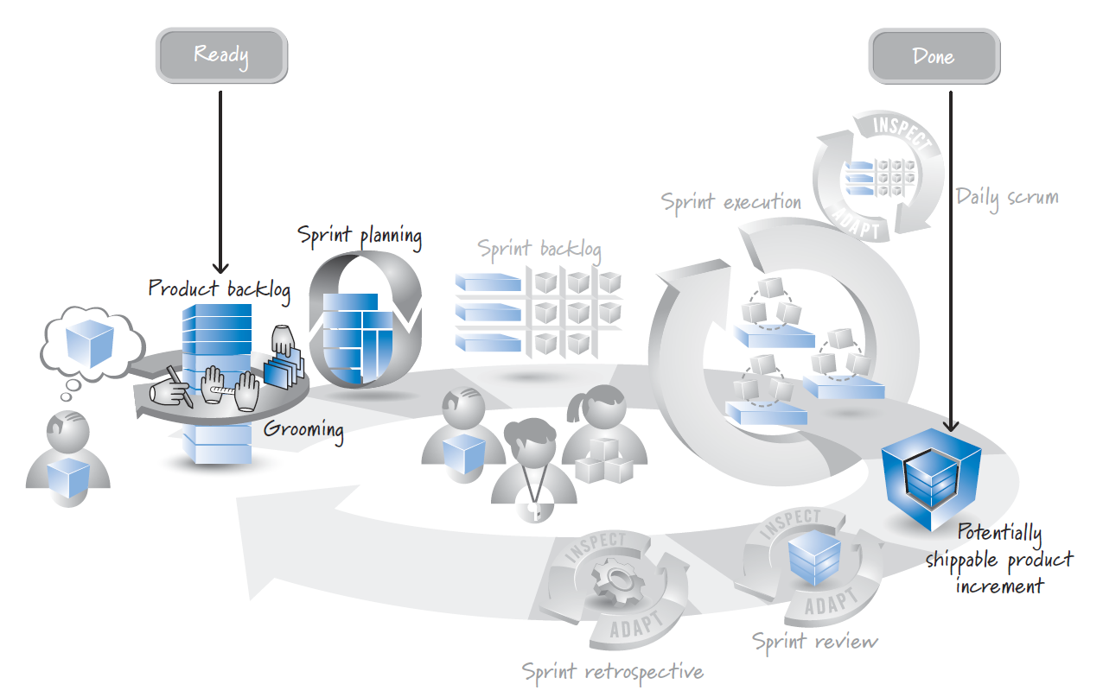
Definition of Ready

Slide 25
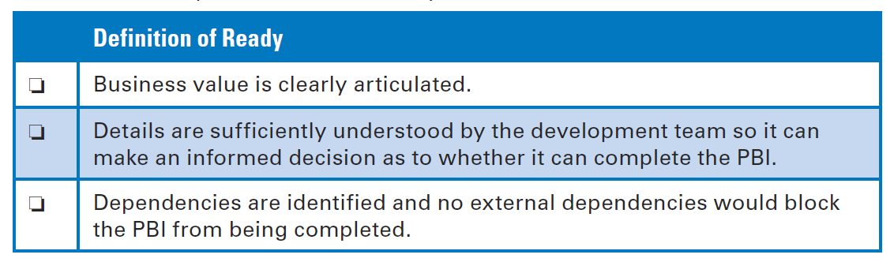
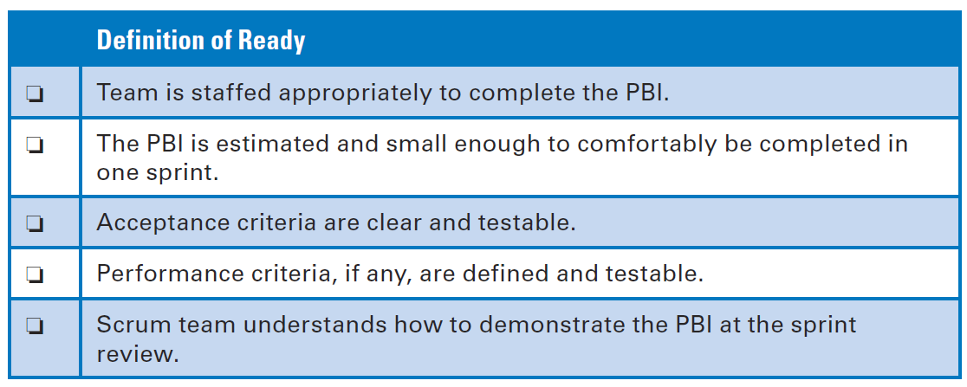
Definition of Ready

Slide 26
End

